Slide 1
Near-Surface Geophysical Investigation of the 2010 Haiti Earthquake Epicentral Area
Eray Kocel, Robert R. Stewart, Paul Mann, and Li Chang
AGL Research Update, University of Houston
April 2014

Slide 2
Outline
Introduction
2010, Haiti Earthquake with 200,000 death
No surface expression
Recent studies suggesting the existence of a blind fault
Selection of Survey Location
Léogâne fan= Epicentral area
No prior on-land seismic reflection data
Geophysical data
Density and Ultrasonic Lab. Measurements
Seismic Data
P-wave Refraction
Shear-wave via MASW
Shear-wave refraction
P-wave reflection
Gravity Data
Integrated Near-Surface Results
What we have learned so far

Slide 3
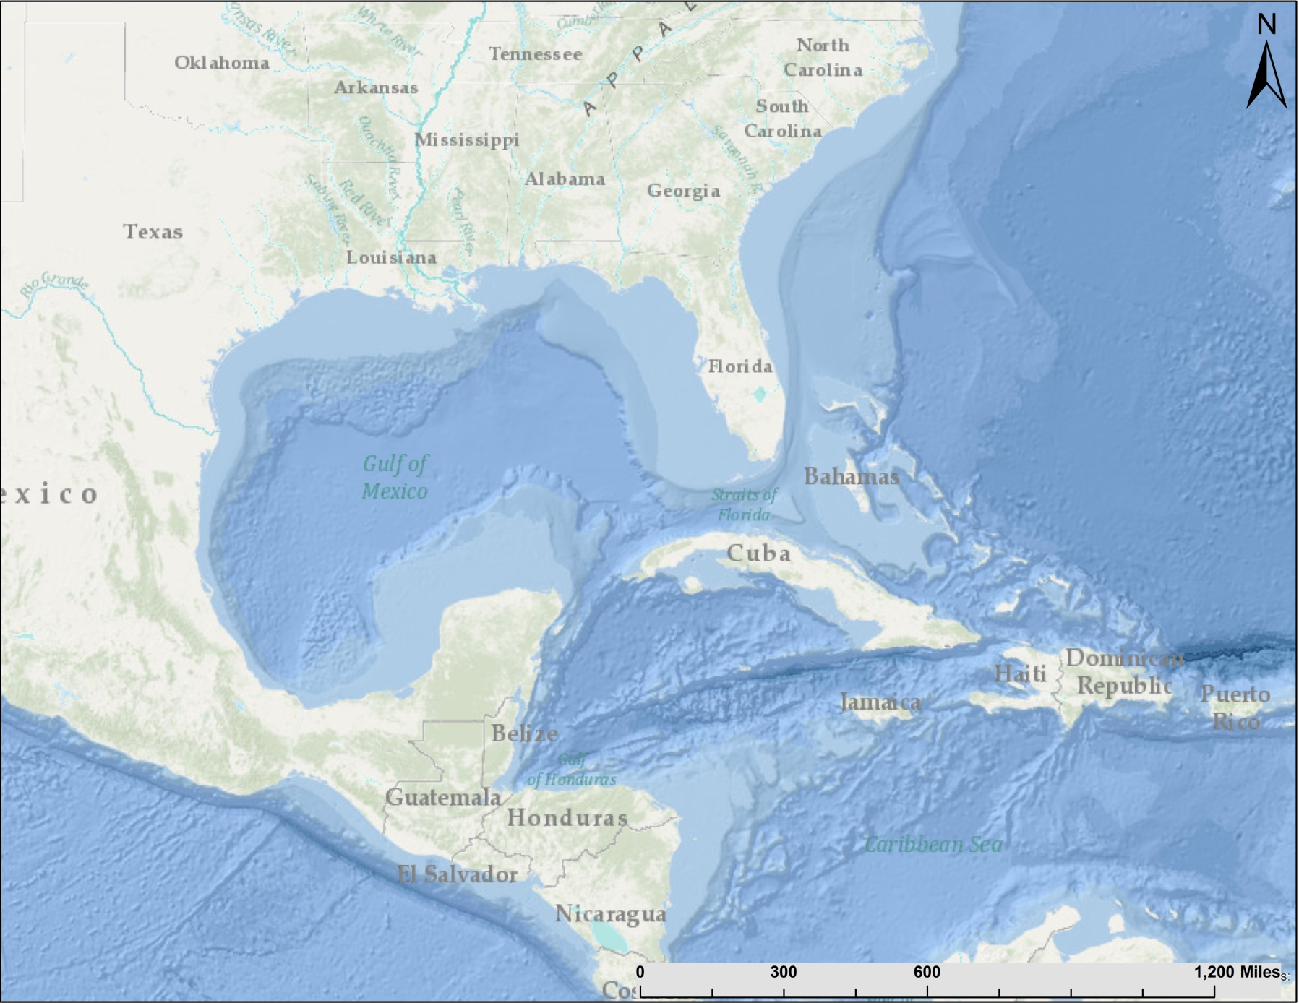
Haiti
We are only 900 miles away from a major plate boundary
Houston
North American Plate
Hispaniola
Caribbean Plate

Slide 4
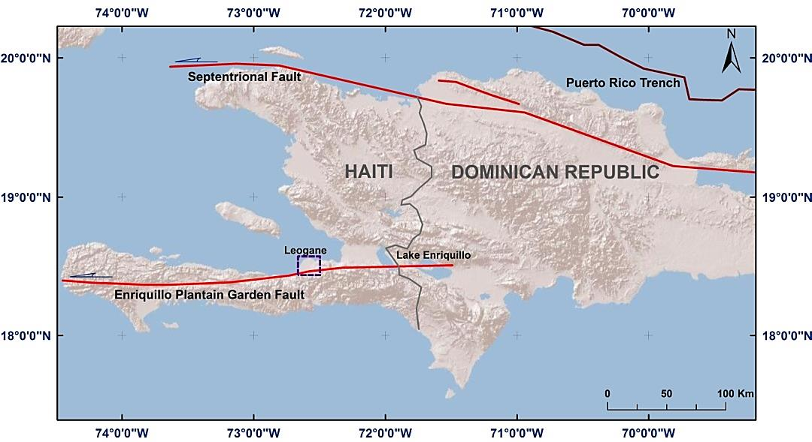
Haiti Project
January 12, 2010, 7.0 magnitude.
Known: Major strike slip fault,
Enriquillo Plantain Garden Fault Zone.
Hypothesis: Unrecognized, neighboring fault (Léogâne)
2010 Earthquake epicenter
Objective
Characterize and analyze the subsurface structure
Measure near-surface sediment properties
(3) Attempt to find and understand the blind faults that may have given rise to the 2010 earthquake
(4) Better understanding the local geology

Slide 5
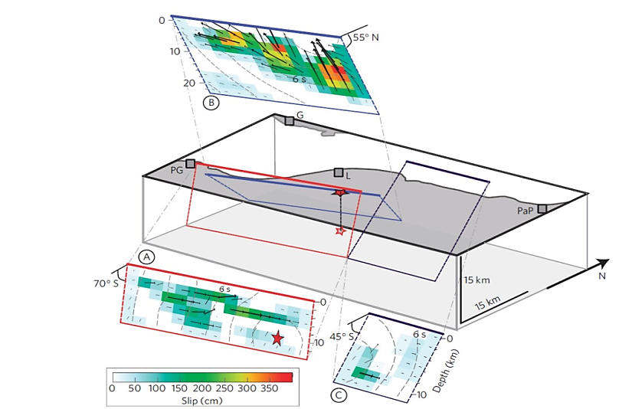
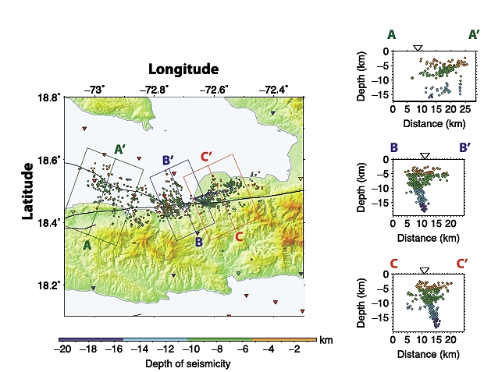
Survey Locations
Why Léogâne?
Recent studies concentrated at this area
Interferogram and Aftershock studies
Uplift studies
Aerial and Satellite images
Seismicity studies
Enriquillo fault is dipping towards south
Léogâne fault is dipping towards North
Hayes et al, 2010
Calais et al, 2010

Slide 6
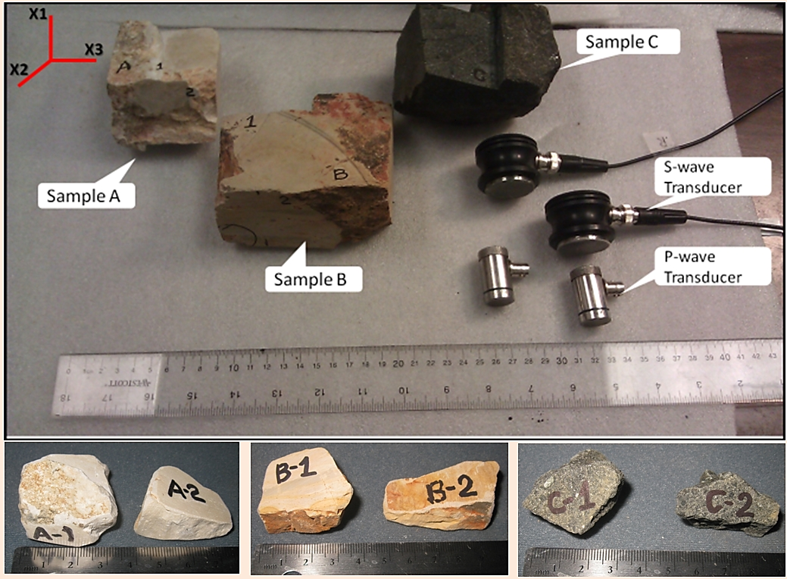
Laboratory Measurements
Sample B
No outcrop in the area, only fan sediments
Sample A and C collected 20km away
Sample B is collected 5km away
Survey location; Just south of EPGFZ
ρ= V_{p}^{0.25}
= 0.31, V_{p}= 2250 m
Gardner’s relationship
ρ _{estimated =} 2.13 g/cc
ρ _{measured=} 2.01 g/cc

Slide 7
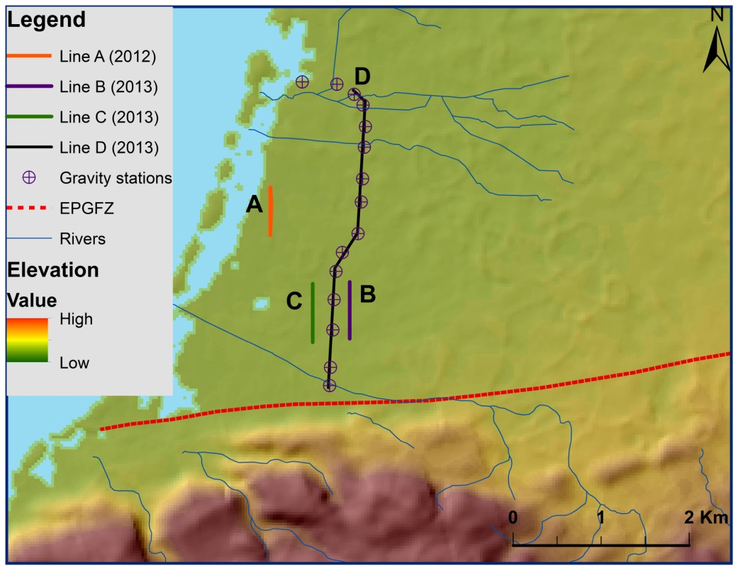
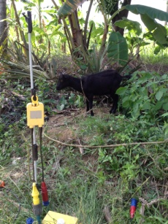
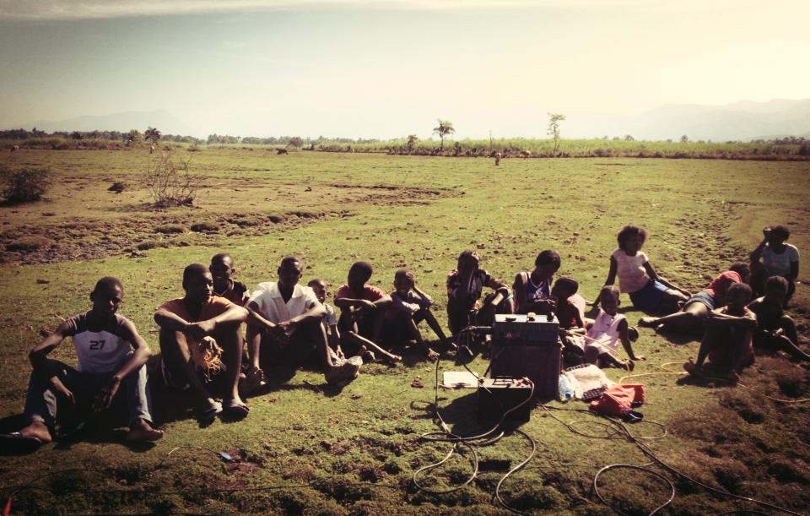
Léogâne Surveys
Sources:
2012- Hammer Source 4.5 kg
2013-Accelerated Weight Drop 45 kg
2014- Vibroseis

Slide 8
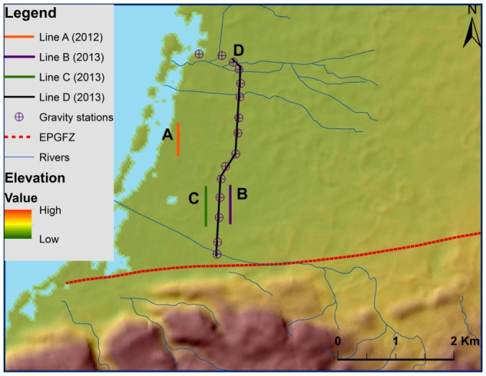
P-wave Refraction Studies
Analysis completed on 2 seismic lines (Line A and Line B) for a 80 m deep model
Line A
(1)Top layers are thicker towards south
(2)Low P-wave velocities for top 40 to 50 m
(3)Relatively consolidated layer boundary is located between 40 to 50m
Line B

Slide 9
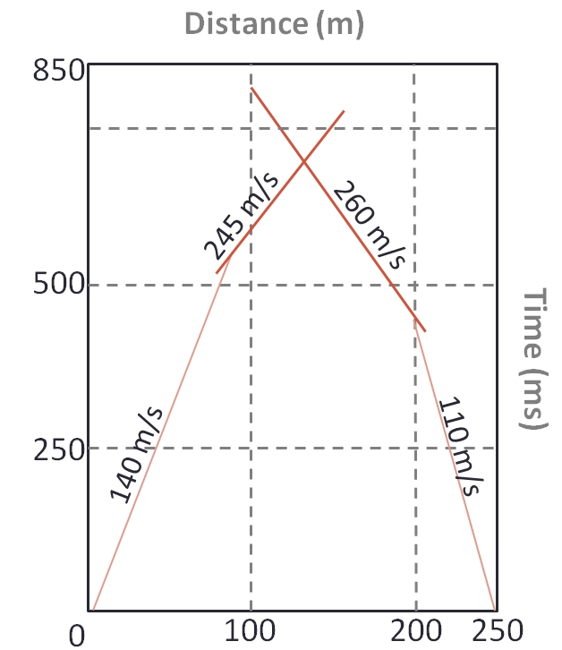
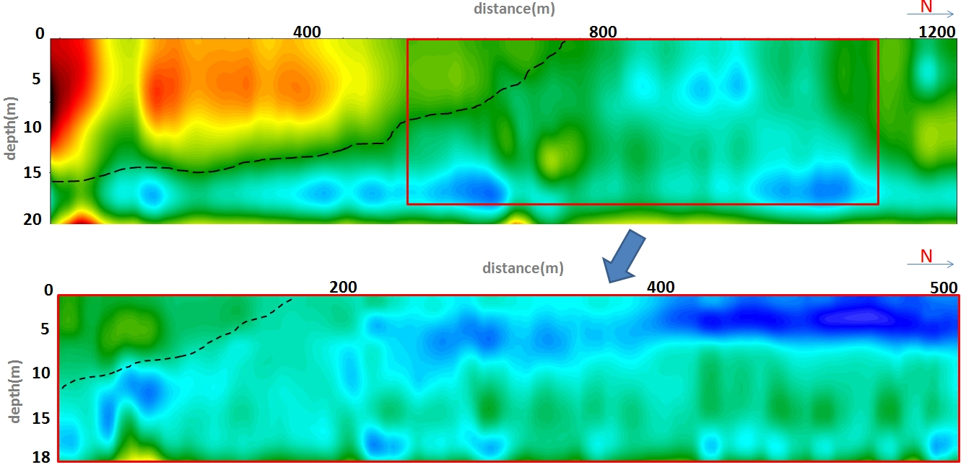
Shear wave studies
Shear wave velocities obtained by MASW method
Line A
Low S-wave velocities for 20 m deep model
Line A- top layer shows slight thickening towards south
Overlapping lines (B and D)
Velocity inversion on line B and D observed
Line D
Line B

Slide 10
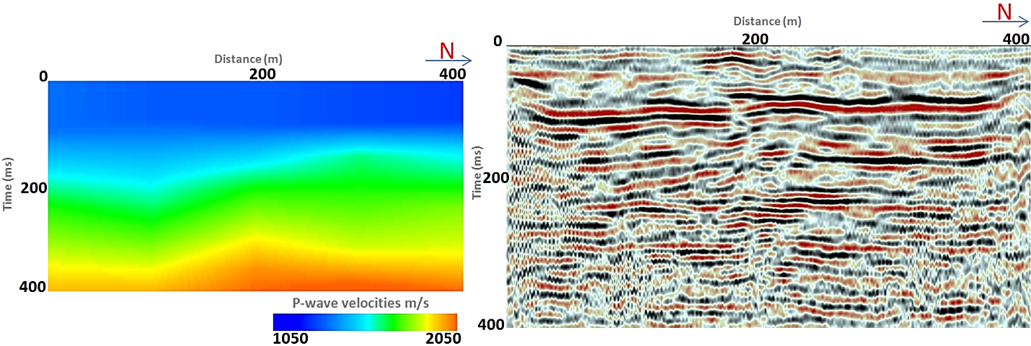
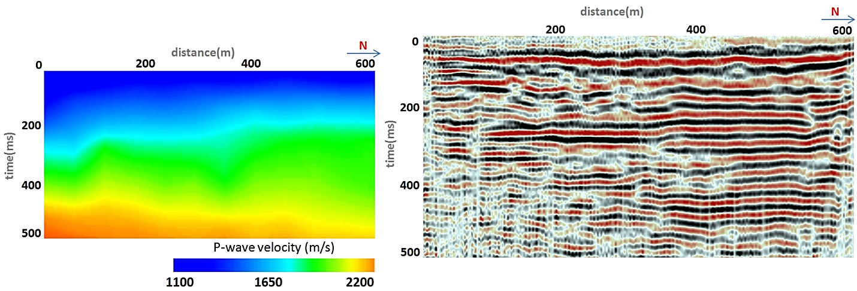
P-wave Reflection Studies
Time migrated images revealed up to 500 ms (roughly 350 m)
Line A
Overall low velocities observed
Top-low velocity layer thickens towards South
Abruptions and discontinuities observed
Strong reflection around 60-80 ms
Line B

Slide 11
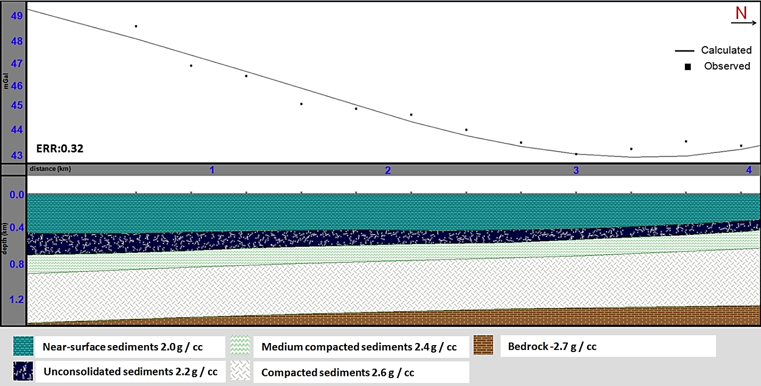
Gravity Analysis
Top sediment density obtained from lab. measurements and Gardner’s estimation, 2.0 g/cc
The bedrock the density is 2.7 g / cc
No prior well or seismic data
Thinning of layers towards North.
Localized gravity anomalies interpreted as the affects of faulting

Slide 12
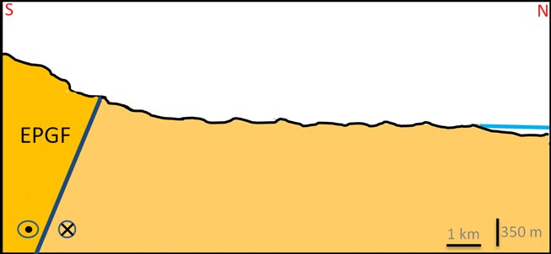
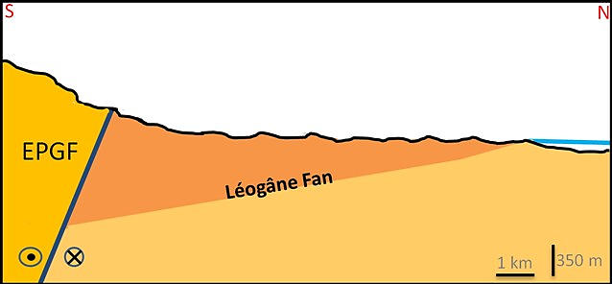
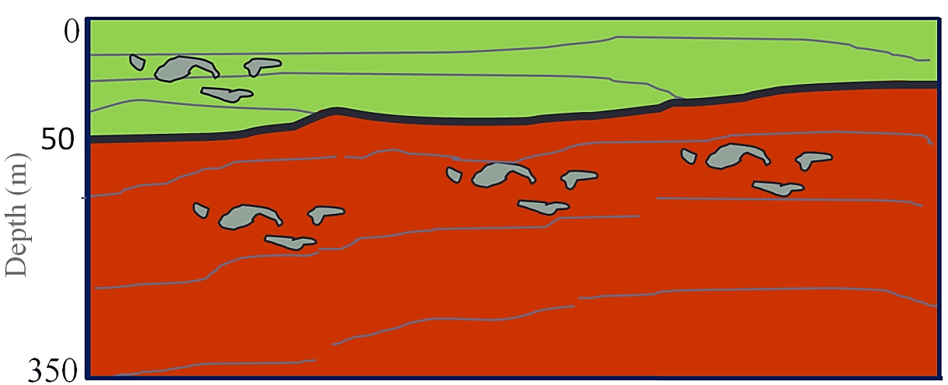
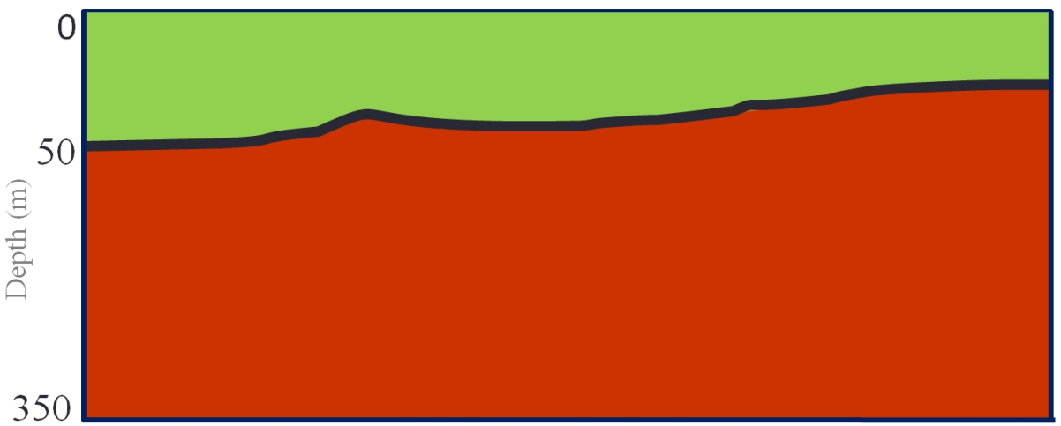
Integrated Near-Surface Results
Known: (1)EPGF dipping south, (2)survey location
Gravity surveys: Thinning of fan sediments towards North
Refraction seismic: (1)Thickening low velocity layers towards South, (2)Boundary at 50m
distance
Reflection seismic: (1)Channel bodies, (2)Some minor faults
depth
Subsurface Layers
Relatively consolidated limestone unit
Lab. Measurements with Seismic: Limestone vs unconsolidated sed. Boundary around 50 m
<2250 m/s
>2250 m/s

Slide 13
Future Plans
Completed
2012 and 2013 surveys were completed
Near-surface analysis provided useful geotechnical information
First on-land reflection seismic data
Tested node systems
Future plans
2014 surveys with stronger seismic source
Imaging target up to 1-2 km
Full deployment of nodes (donations from Geospace)

Slide 14
Acknowledgements
Geoscientists Without Borders
Allied Geophysical Laboratories
Anoop William
Haiti Bureau of Mines and Energy employees
Gedco-processing software

Slide 15
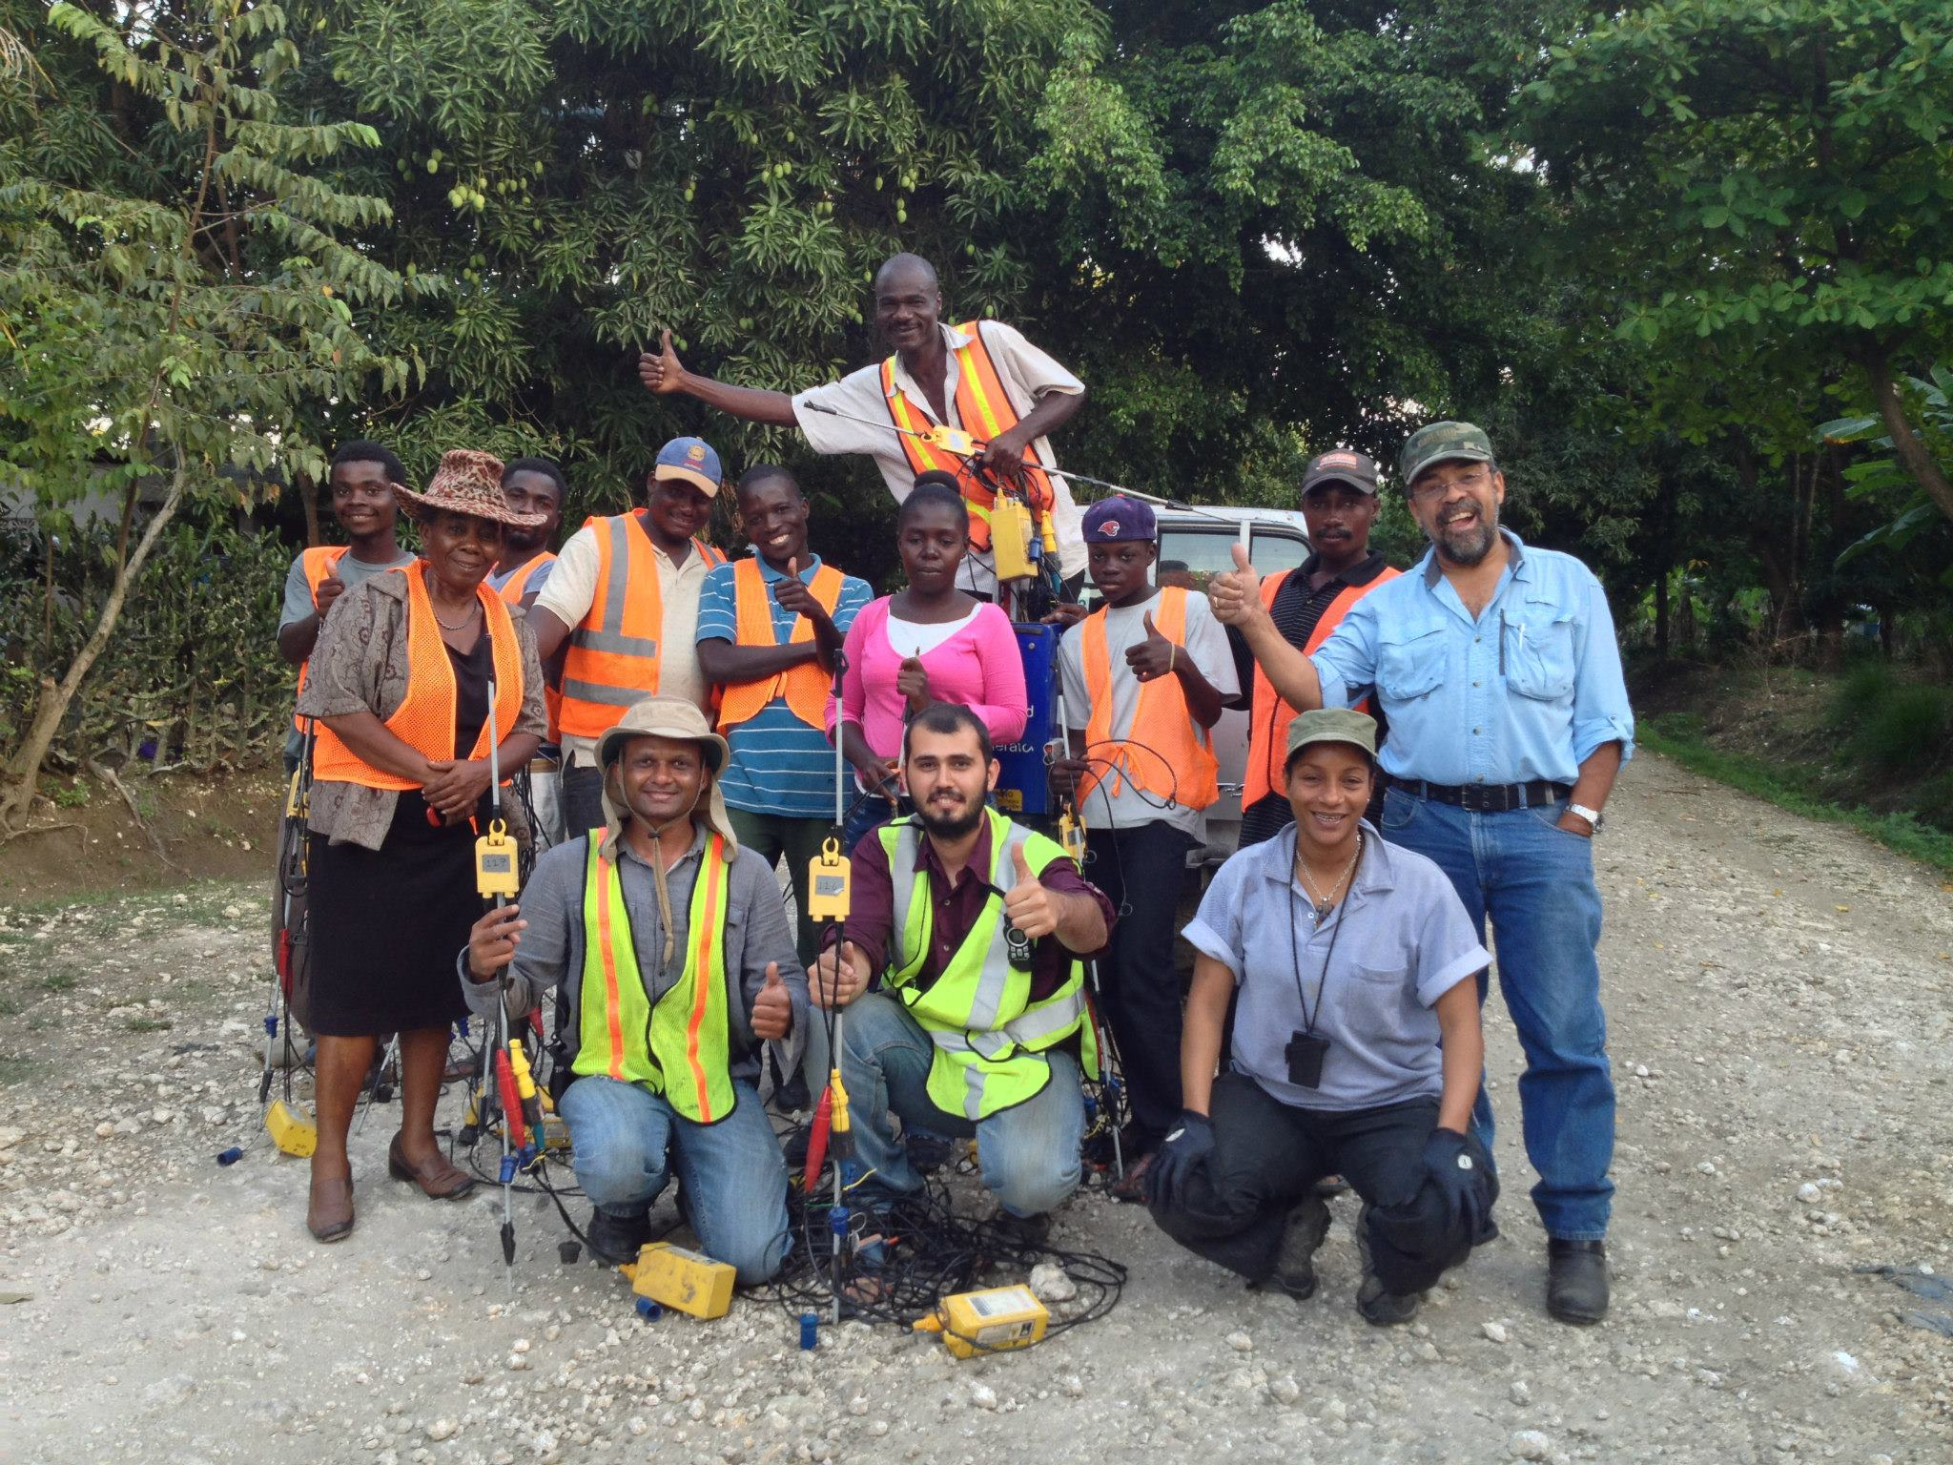
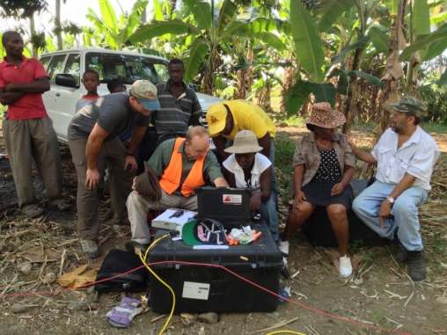
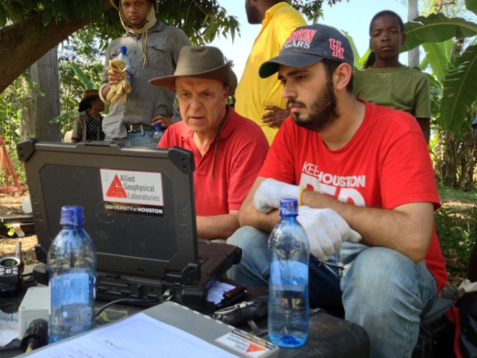
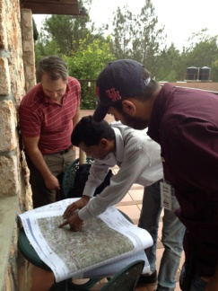
THANK YOU

Slide 17
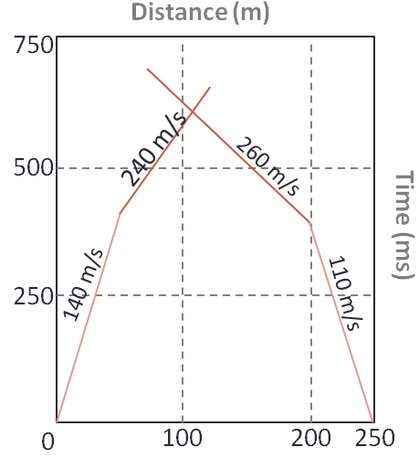

Slide 18
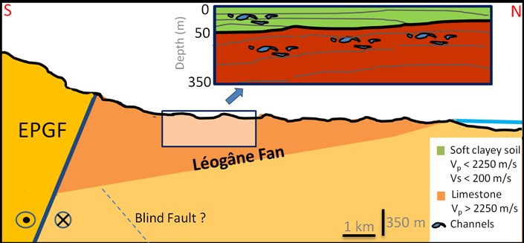
0
50
Depth (m)
350
0
Depth (m)
50
350

Slide 19
Houston
North American Plate
Hispaniola
Caribbean Plate

Slide 20
Future Work
distance
depth
Subsurface Layers

Slide 21
Integrated Near-Surface Results
Laboratory Measurements
Seismic Data
Refraction Data:
Reflection Data
Shear Data
Gravity Data:
Due to limited spread of the gravity line over the Léogâne fan (roughly 3 km). Depth of investigation is around 1.5 km (half of the offset, at best), which should mainly reflect the change over the fan thickness
Gravity readings are decreasing towards north (away from the main fault, due to thinning of the fan). Localized variations of the gravity readings are interpreted as the affects of faulting
Laboratory Measurements:
Densities and velocities are calculated
Sample B identified as a layered limestone
Sample B has velocity range of 2.35 to 2.92 km/sec, and density of 2.01 g/cc
Gardner relationship (using V_{p} from refraction analysis) estimated the density 2.13 g/cc
Seismic Data
Refraction Data
Reflection Data
Shear Data
Gravity
Laboratory Measurements
Seismic Data
Refraction Data:
Reflection Data
Shear Data:
The results obtained from MASW studies indicate ranging velocities of 130-200 m/s for shear wave
The inversion of high velocity layers interpretetd as the channel bodies. Coarse .... can have relatively higher velocities
On a similar tectonic region (San Francisco, California), these velocity values suggests that the near surface soil at Léogâne fan is ‘’Class E’’ or unconsolidated and highly saturated sediments. We believe that the unconsolidated, soft, seismically slow soil is the reason for the devastation at the nearest city (Léogâne)
Gravity
Laboratory Measurements
Seismic Data
Refraction Data
Reflection Data:
Vertical-cable lines were able to image up to 500 ms, roughly 350m
On all seismic sections, some disruptions at the subsurface layers and discontinuities were seen within the first 200 ms of data, which suggests a complicated shallow subsurface geology
We identified discontinuous layers as 20-50-m thick channel bodies deposited on previous fan surfaces
Strong reflections observed around 80-100 ms, which corresponds to velocity contrast around 40-50 m. on refraction models.
The contrast may be due to transition from weak, seismically slow layers to relatively more compacted limestone layers (refraction velocities are in the order of lab. measurements for sample B)
Shear Data
Gravity
Laboratory Measurements
Seismic Data
Refraction Data:
Velocities between 500 m/s and 2250 m/s for 80 m deep model
Slight thickening of low velocity layers towards south (EPGFZ)
Top 40-50 m of the subsurface is highly saturated and seismically weak sedimentary layer
Deeper velocities are similar to the measured velocity of Sample B(Limestone)
Reflection Data
Shear Data
Gravity

Slide 22
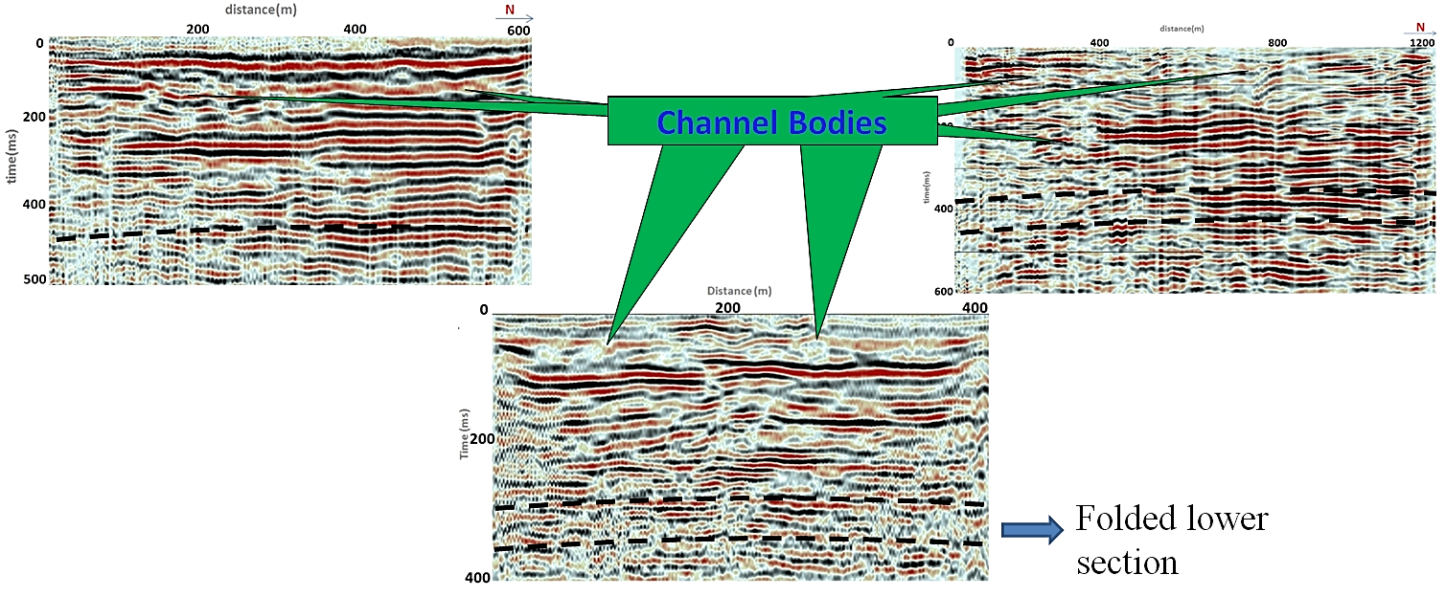
P-wave Reflection Studies

Slide 23
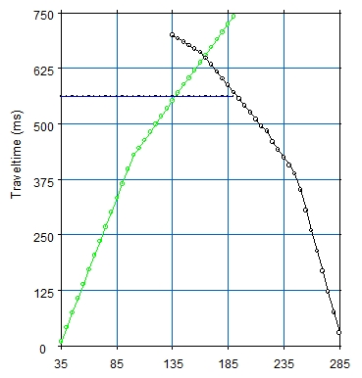
Distance (m)
850
245 m/s
260 m/s
500
Time (ms)
140 m/s
250
110 m/s
200
250
0
100

Slide 24
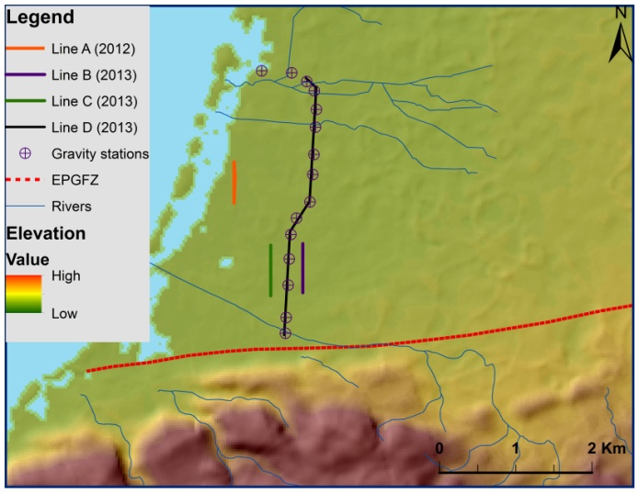
Shear wave studies

